Slide 1
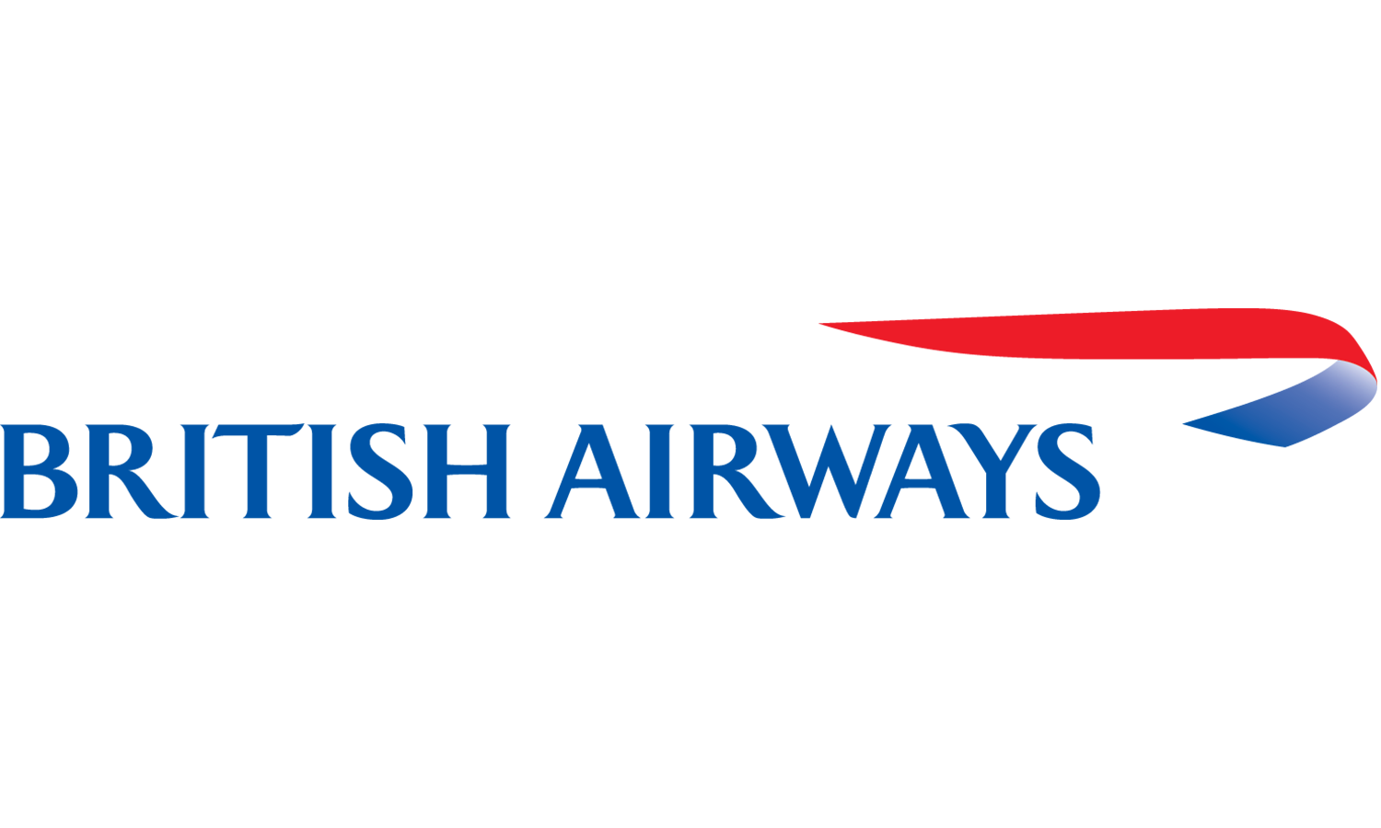
Web Scraping to Gain Company Insights
By: Ece Yavuzyılmaz
21/04/2023

Slide 2
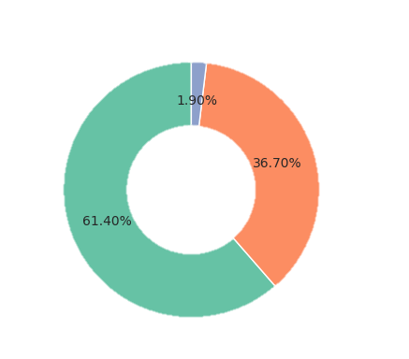
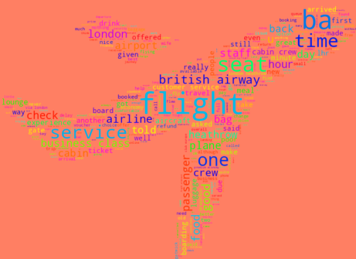
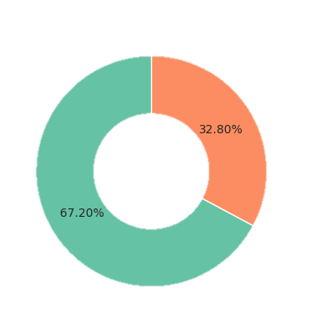
VADER Analysis Conclusion
614 of the customers have positive reviews, 367 negative, and 19 neutral.
Word Cloud
Sentiment Analysis
VADER and Textblob analyzes were used for sentiment analysis. Analysis results from clearing 1000 reviews submitted by customers are shown following.
Textblob Analysis Conclusion
672 of the customers have positive reviews, 328 negative.

